Slide 1
Capstone
Department of Engineering, Computing, and Cybersecurity
Stefanie Perez

Slide 2
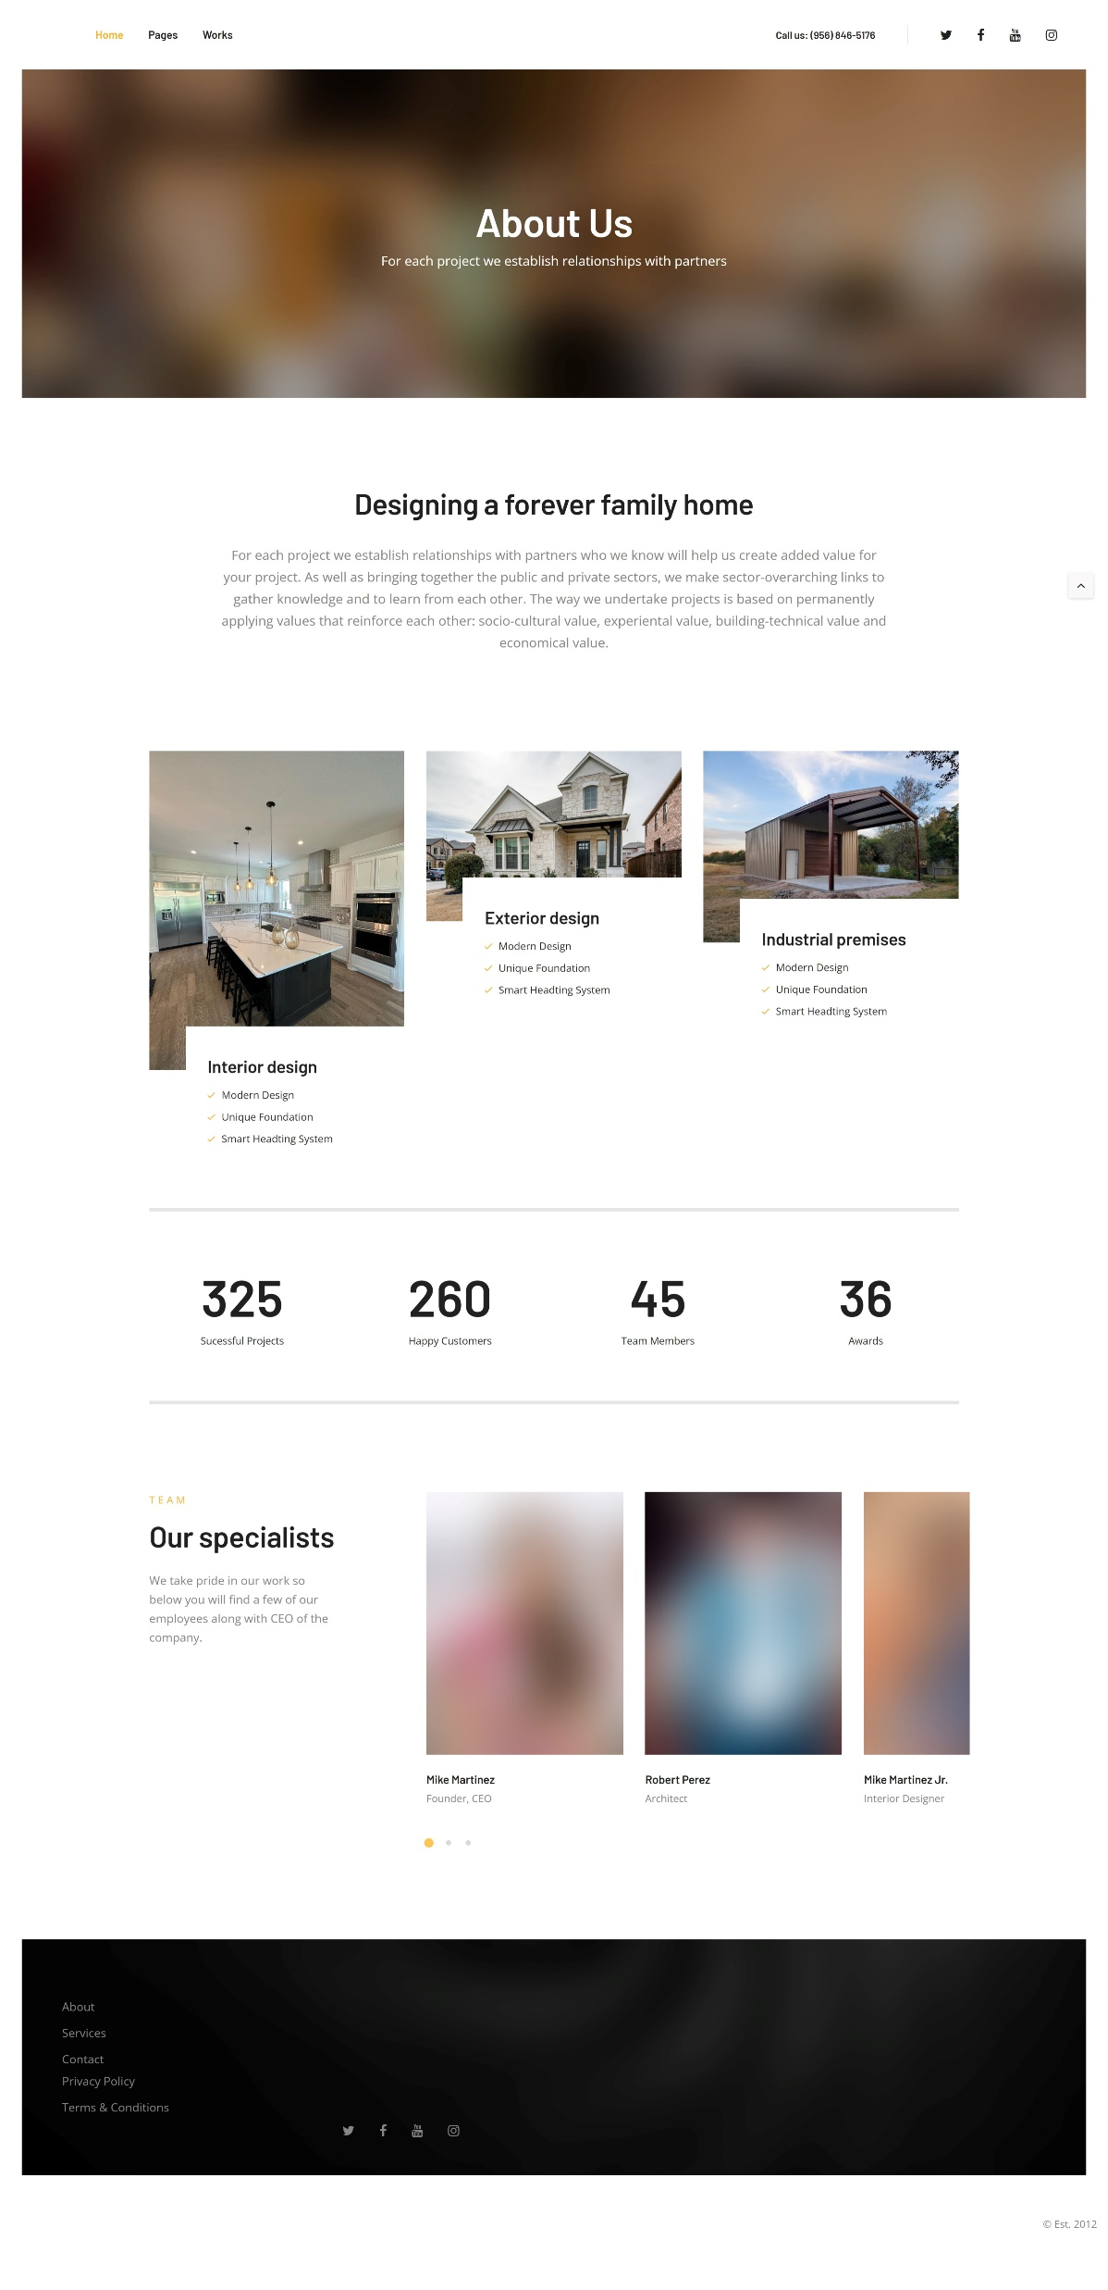
What is my project?
My project is based off a construction company from McAllen TX who advertises their work through Facebook. This website will help him in ways to reach out to customers to show them what type of work he does.

Slide 3
Who I did my website for
I did my project for my best friend's dad who has his own construction company on the side named Mike’s Construction. He's had his little business since 2012 and eventually started growing through the Rio Grande Valley.

Slide 4
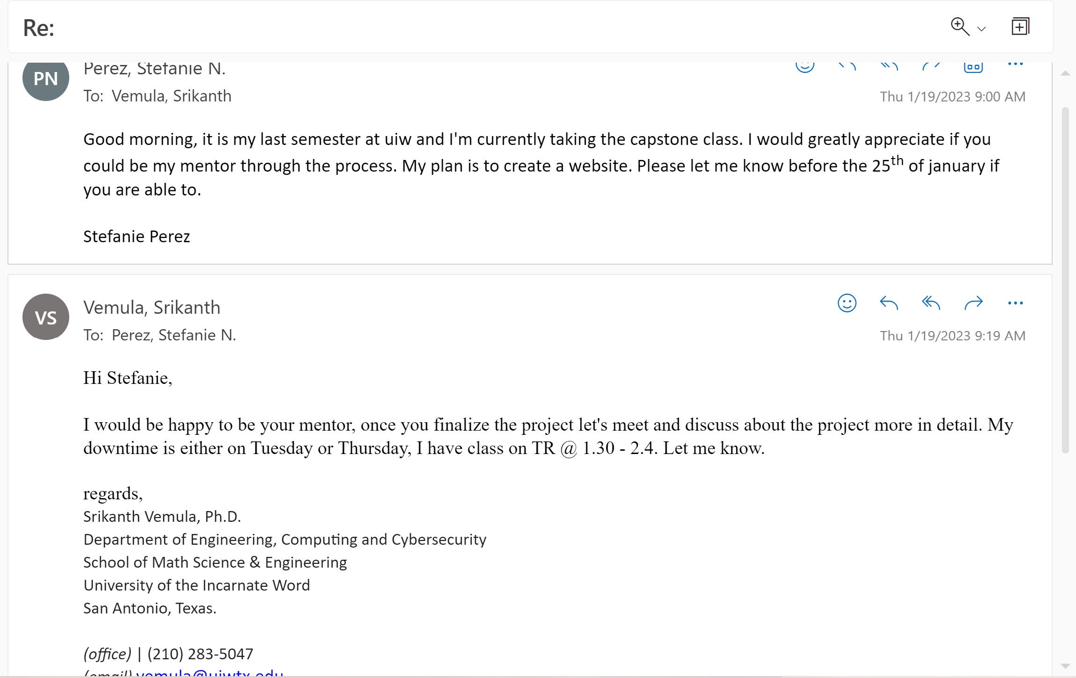
My mentor
The mentor I chose was Srikanth Vemula.

Slide 5
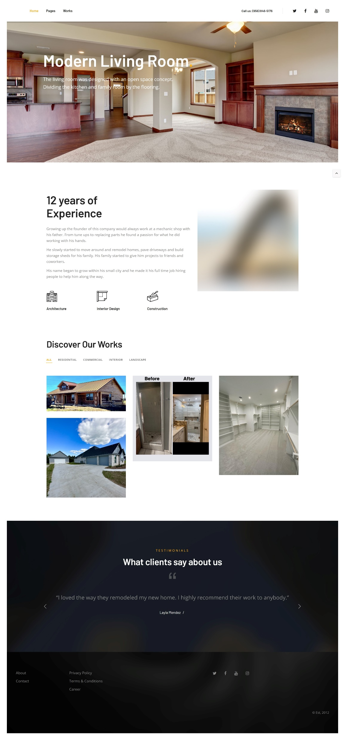
Goal of my project
The goal of my project was to create a website that is easy to navigate for customers who either want to build or remodel their home. I want it to show customers the type of work he does and the quality of work he provides.

Slide 6
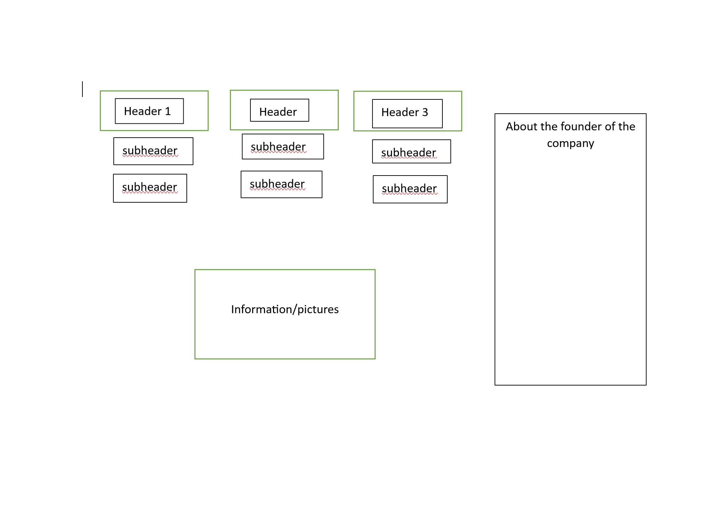
Conceptual Design and materials
Visual studio code
Microsoft Word

Slide 7
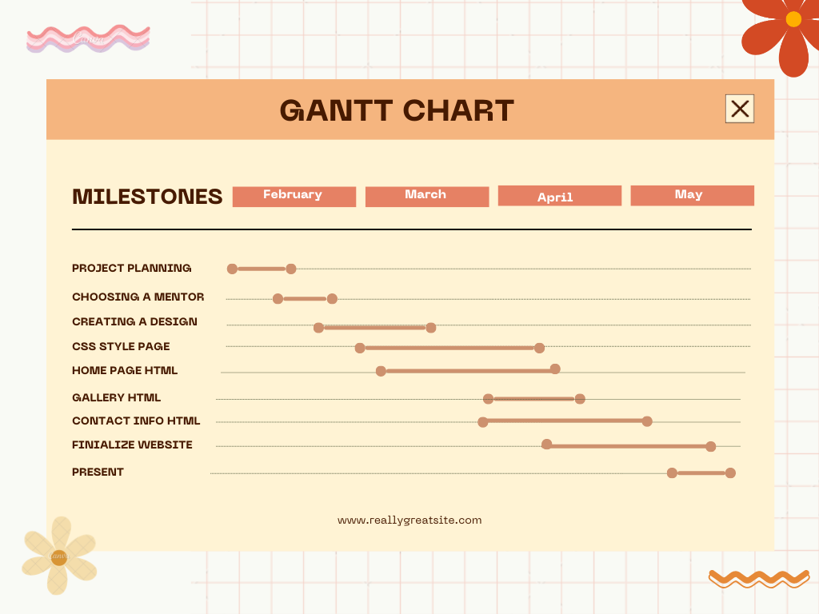
Gantt Chart with milestones

Slide 8
Challenges
Coming up with a design for how I want it to look
Building the code without errors
Styling the css to get the right area for text/pictures

Slide 9
Success within the project
Designing the website to the clients liking
Creating a php for social media pictures
Easy to navigate website
How to properly build a website

Slide 10


